Slide 1



Financial
Model
Page 1
Staffing
Approach
C-suite
Timetable
Curriculum
Empowering Education
Page 20
Assessment
Pedagogy
Management
Structure
FIND OUT MORE ON:
Corporate website:
www.ritzyschools.com/c-suite
CONTACT US:
E-mail:
business@ritzyschools.com
C-suite

Slide 2


Page 2
C-suite is a Centralised Educational Governance System that offers 21st century education solutions to promote deep learning and fostering the success skills of critical thinking, problem solving, collaboration and self-management essential in the workplace of tomorrow.
Page 19
Building Address
E-mail Address
Business Hours
Contact Us
Follow Us
#1-115-86-B, Sneha Twin Villa, Vinayaknagar, Hafeezpet, Telanagana - 500049
Calling Numbers
info@ritzyschools.com
INTRODUCTION
24/7
www.ritzyschools.com/c-suite
+91 9959647746
Education
Partnership
“
An investment in knowledge
pays the best interest.
Welcome
“

Slide 3
C-suite opens up the world of enchanting assets, expands it and allows you to improve your essence in so many ways.
“
Page 18
Page 3
Dr Aperna Volluru
k
“
The Centralised School System enables the Schools to save their investments in financial and educational resources and expertise in effectively developing and implementing the model that usually only large schools can invest to reach a larger number of pupils with high quality education.
Our Mission
Our Goal
To provide the very best education for all and the highest level of support for our schools and staff.
EDUCATION
EXCELLENCE
EVERYWHERE
Our Belief
The power of literacy can lift people out of ignorance.
Save Time
& Money
Parents save time and money on after school tuitons and coaching for their children. C-suite benefits the students with well experienced and qualified teachers who establish the base for academic excellence at zero cost.
Our Vision
Our Promise
With C-suite steering schools, we ensure every school will have everything they need to reach their full potential.
FORESIGHT
EDUCATION

Slide 4





Page 4
Page 17
100%
80%
60%
40%
Begining is Half Done
Corporate Image
Branding Strategies
Parent Empowerment
Relieving Overburdened Management
Enhancing Admissions
01
02
03
04
05
Centralised School
Governace
Kindergarten In Italy
Kindergarten In Europe
Global Franchising
C- suite
University
OurJourney
2015 brought us to Nepal, Bangladesh & India with our European Currirulum and today we have over150 Kindergartens in ten states of India.
In 2009, Ritzy Group started its first Kindergarten in Bari, Italy as My School ITALY.
In 2012, Ritzy Kindergartens expanded to various countries in Europe. Mercedes Benz became our Partner in Germany.
2021 sees the launch of Ritzy C-Suite to empower education and foster it for future. This is first of its kind to kindle the Indian education industry.
2026 Ritzy will see us entering into the world of Higher Education in many developing nations.

Slide 5





Page 16
Page 5
Broad
Intellectual
Capital
Cherished
Extensive Relationship
M &
Tripple A
Needs
Leading
Classroom
Solutions
Experimental
Experiencial
Learning
This Is What We Got so Far
NATIONAL
294
85
Better Decision Making
&
Accelerated Results
INTERNATIONAL
Noble Prize 2014
Euopean Business Award 2019
Guiness Record 2020
India Didactics 2019
Best MSME 2019
Best Iconic Brand 2020
“
Success is connected with action. Successful people do what unsuccessful people are not willing to do.
How
Are
You
Empowered
“

Slide 6









Page 6
Page 15
The three Bs
The details are not the details. They make the design.
Build an ecosystem with 7 elements for academic excellence.
Financial Model
Hiring and Staffing Model
Bridge gaps in the school administration through our SOPs.
Bespoke integration approaches, priorities and operating models.
Build
Bridge
Curriculum and timetable
Bespoke
KEY ELEMENTS
Pedagogy & Assessment
How
We
Do
It
Management Structure & Approach

Slide 7





Page 14
Page 7
Behind The Stage
Dr Aperna Volluru
Dr Aperna Volluru has worked for over three decades across the education sector in Europe, Africa and Asia, including private and non-profit school groups, higher education and education services. She has published on both strategic and commercial diligence questions.
Prior to founding Ritzy Schools, Dr Aperna Volluru served as a policy analyst to Hon Michele Giove, former Secretary of State for Education (Italy), where she worked on a variety of policy reforms, including academies and free schools. Dr Aperna Volluru was also on the Integration Program of Government of Italy as a Child Psychologist.
To hold such positions, it is mandatory that one must have completed more than 1,000 projects across 70 countries in the education sector. Projects span the full range of the education sector, including commercial and non-profit; pre-K through to post-secondary and continuous; schools, services, technology, systems, content, assessment, and more. Hence, such is the experience that Dr Aperna holds today apart from many International Awards and Accolades to her name.
Dr Aperna Volluru holds a BSc in Computer Science (UK); MSc in Computer Science (UK); MA in English Literature (UK) and PhD in Child Psychology (UK).
Lack of wide-ranging skills and experience to turn the curriculum into dynamic lessons that ignite the imagination and prepare students for tomorrow’s ever-evolving society.
Unable to cope up with the parents, students and staff needs, evolving technologies and fluctuating markets. Hence after certain number of students, Management restricts its own intake.
Drawing students interest towards educational concepts has become challenging for teachers.
Insufficient savvy and support makes admissions a major challenge for schools.
Schools cannot hike fees year on year without resistance from parents.
Come With Problems
Academics
Faculty
Entrepreneur
Admissions
Fee
Academician
Management
Psychologist

Slide 8
Page 8
Page 13
Academics
Faculty
Team Work
Admissions
Success Project
Fee
Management
Go With Solutions
Founder - Dr Aperna Volluru
CEO - Eng MNR Gupta
MEET Our
Team
Regular upskilling programs for Teachers lead to their high performance, prepare them to adapt to this age of information overload and without extra effort implement New Education Policy in 2023.
MD - Mr KC Andreazzo
Brand plays a key role in getting admissions. All the achievements, awards and accolades are passed on to C-suite affiliates which amplifies the school image in one go.
Enhanced possibility to run one or many schools simultaneously with infinite intake as schools get a corporate structure that helps them to reinvent the now, reshape the next and reimagine the beyond.
Our Neuroscience based educational elixir converts students’ ‘Fear of Learning’ to ‘Joy of Knowing’, hence annhilating ‘Back Benchers’.
Parents with higher paying capacities will flock in, when better brand, curriculum, methodologies and digital solutions are introduced.
COO - Mr Venkat Garshakoti
CMO - Mr Suhail Kachava
ACADEMIC DIRECTOR - Ms C Diana
CREATIVE DIRECTOR - Mr Md Qasem

Slide 9

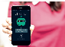







Most advanced integrated curriculum powered by text books, workbooks, Online Live Classes + AR App.
Page 12
of
Page 9
Hand-on methodology sharpens mind, increases mental agility and intelligence.
Education
Student
Things
All Designed To Develop Passion For Learning.
Our study technologies take advantage of the amazing neuroplasticity of the brain.
Faculty
Training
Whatapp
Chatbot
EOT
Management
Branding
Unique, portable, micro-scale labs revolutionising the classroom teaching.
Mobile
Application
Parent
Voice
Communication
Management
Software
Pure Science
Made Easy
Comprehensive impact assessment report.
AI Augmenting Educational Management
EOT enables schools to move on to the next level of Management & Operations along with accelerated admissions.

Slide 10

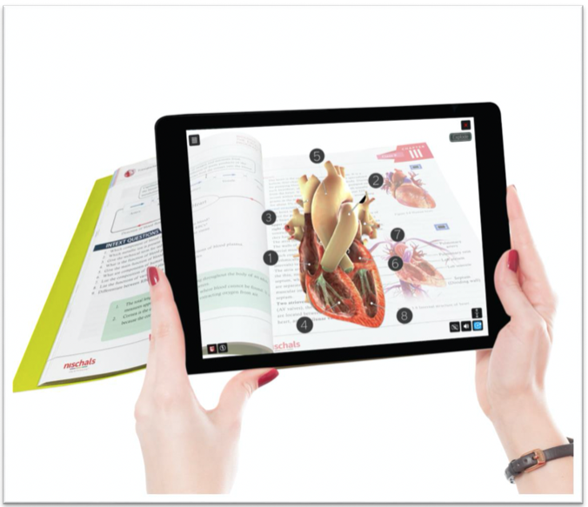

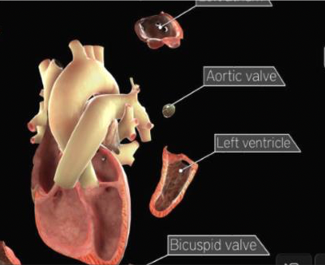







Page 10
Page 11
Powered By Augmented Reality
No matter where our students are in the world we can welcome them into their classroom through our Virtual School Experience. Our high quality teachers bring personalised learning to your secondary through innovative and inspiring lessons.
ParentsApproved Device Learning
Blending real and virtual worlds, our FREE online live classes add to the classroom teaching. Thus multiplying chances of success of our students in exams like IIT-JEE, BITSAT, KVPY, NEET, AIIMS, AIPMT, SATetc.
Bridge the gaps in challenging areas of understanding and offers a platform for interactive learning.
3D Interactive Digital Content
IIT
NEET
Bridge the gaps in challenging areas of understanding and offers a platform for interactive learning.
“
Build skills for today, tomorrow and beyond. Education to future-proof your career.
“

